Slide 1



TASK 3
SONGS ANALYSIS WITH POWER BI
Rohit Kamble
Batch: MIP-DA-10

Slide 2


PROBLEM STATEMENT
In the fast-evolving world of digital content, understanding YouTube songs' performance and engagement is vital for creators and stakeholders. This project aims to analyze YouTube song data using Power BI, focusing on key metrics such as views, likes, comments, and more. By creating interactive dashboards and reports, we seek to uncover trends and patterns that can optimize content strategies. The goal is to provide actionable insights to enhance audience engagement and maximize the impact of YouTube songs.

Slide 3

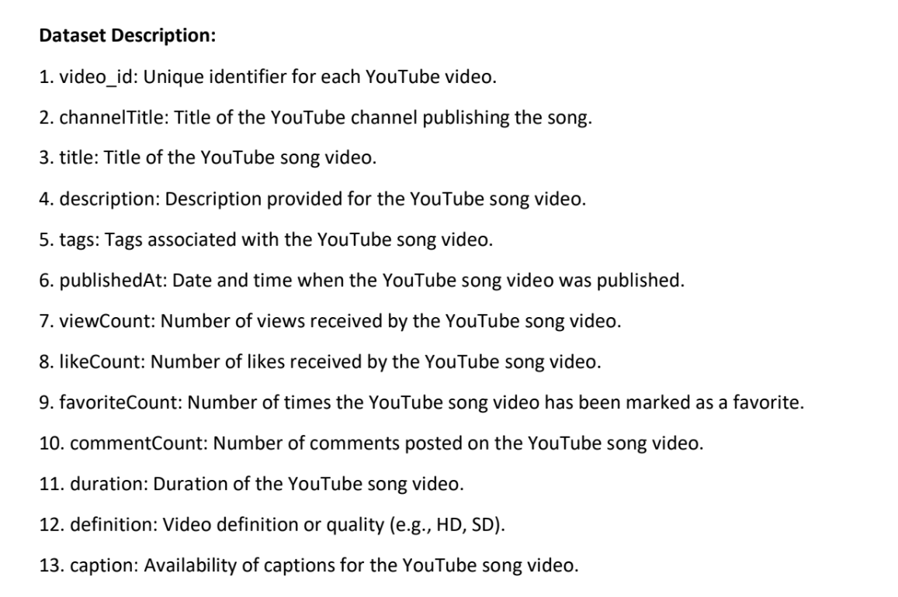
DATASET DESCRIPTION

Slide 4
PROJECT OBJECTIVE
1. Data Cleaning and Preparation:
- Clean and preprocess the dataset, handling missing values or outliers.
- Convert relevant columns to appropriate data types.
2. Exploratory Data Analysis (EDA):
- Explore patterns and distributions in view counts, like counts, and comments.
- Identify trends in the popularity and engagement of YouTube song videos.
3. Content and Channel Analysis:
- Analyze the distribution of videos across different channels.
- Identify popular tags and their correlation with view counts.
4. Temporal Trends:
- Explore how YouTube song video metrics vary over time.
- Identify peak publishing times and their impact on engagement.
5. User Engagement Insights:
- Investigate relationships between likes, comments, and views.
- Identify factors influencing user engagement with YouTube song videos.

Slide 5
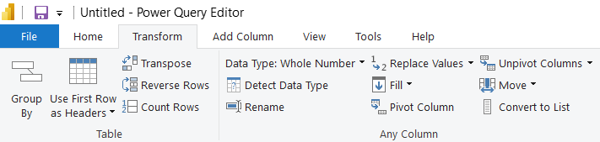
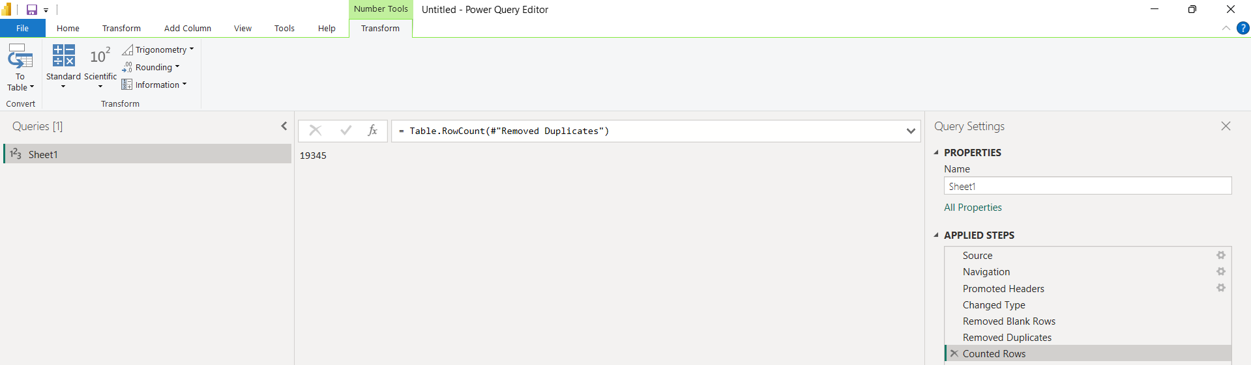
Using the count rows function from transform page in the power query editor
1
DATA CLEANING AND PREPARATION:
Initial number of rows: 19345
After removing the blank and duplicate rows the count remians same that implies data set didnt have any NULL or duplicate rows

Slide 6
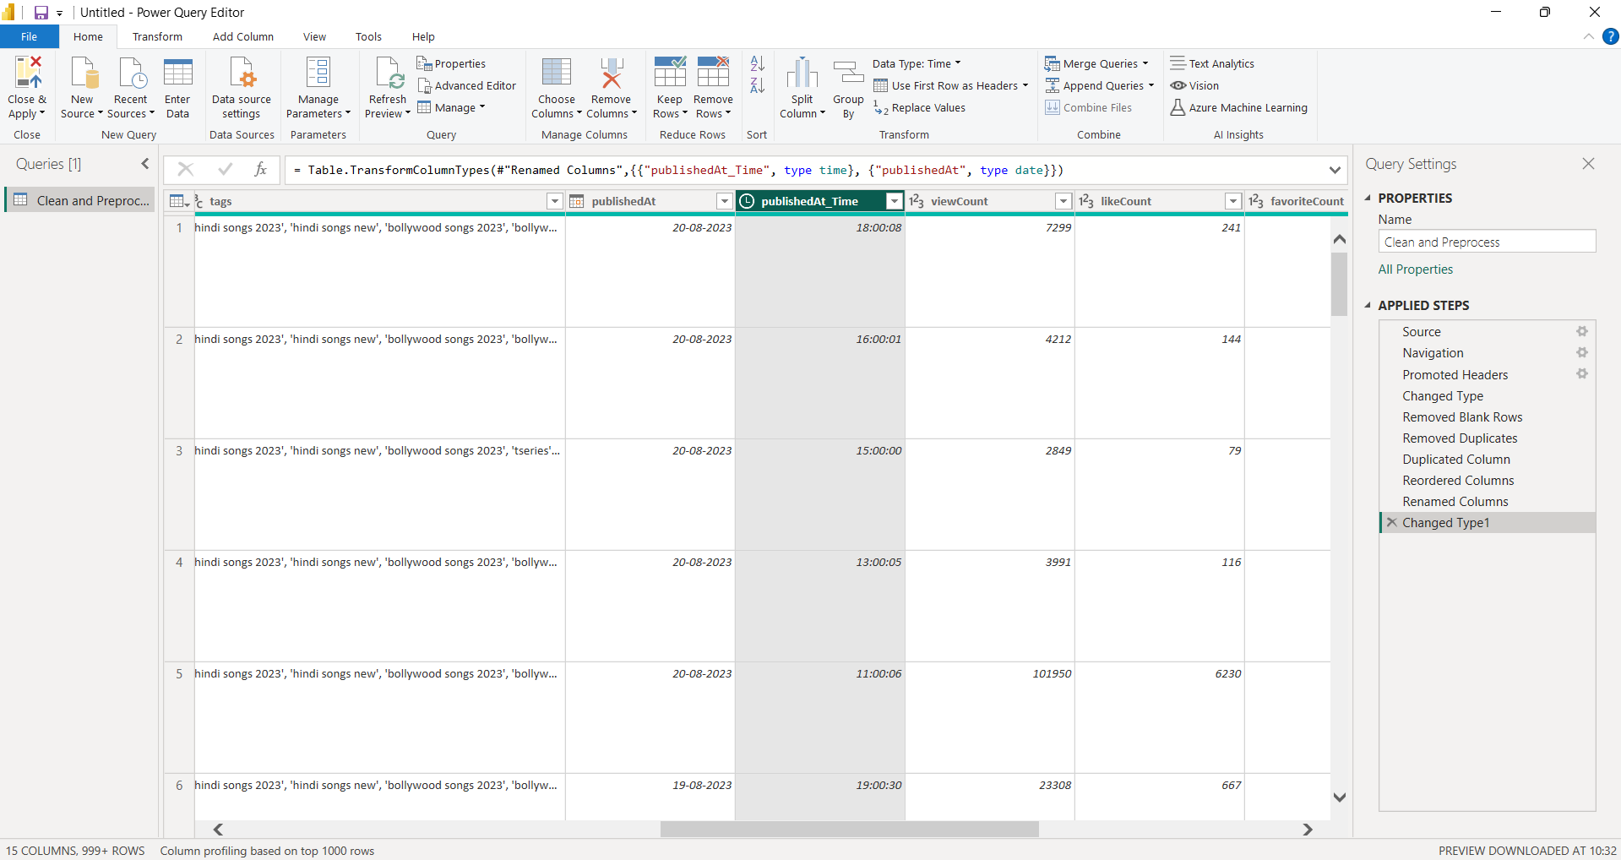
Splited PublishedAt [Date/Time] Into Date and Time for fesibility Date and Time for feasibility

Slide 7
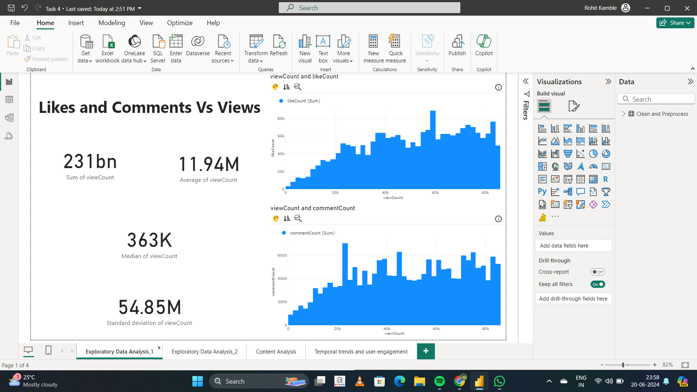
2
Exploratory Data Analysis (EDA)

Slide 8
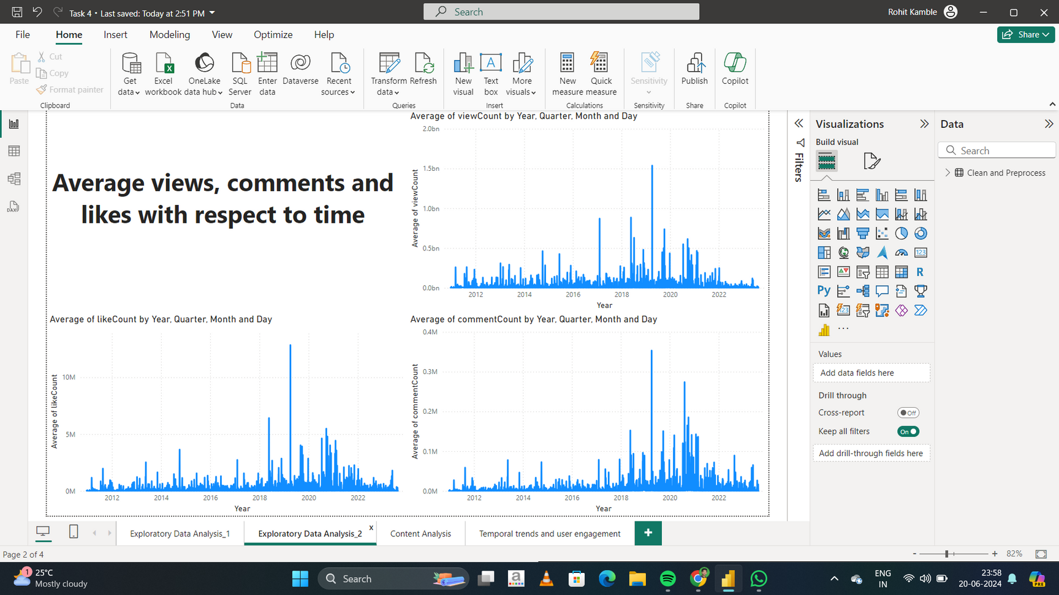

Slide 9
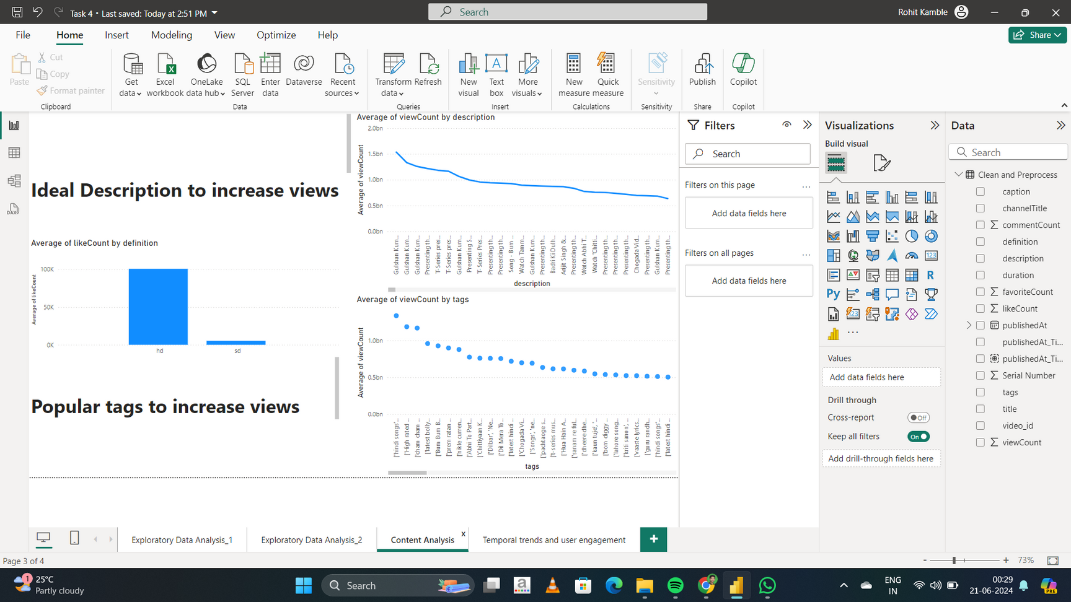
3
Content and Channel Analysis:

Slide 10
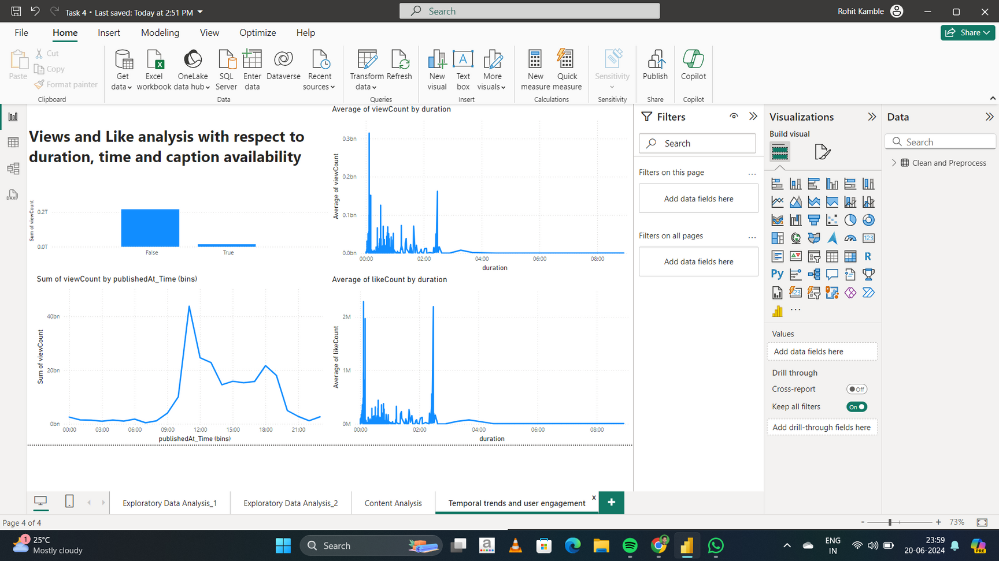
4-5
Temporal trends and user engagement

Slide 11
Its very feasible to do visualization analysis when dataset is clean and properly processed and in proper format
From EDA analysis : With increase in views, likes and comments increases too. Also similar content posted around 2019 must be preferred
KEY FINDINGS
Content analysis show the popular tags and description that must be used to increase engagement
Maintain a consistent posting schedule to build a loyal audience base. Consistency can keep your channel active and encourage repeat views.

Slide 12

THANK YOU

